Slide 1
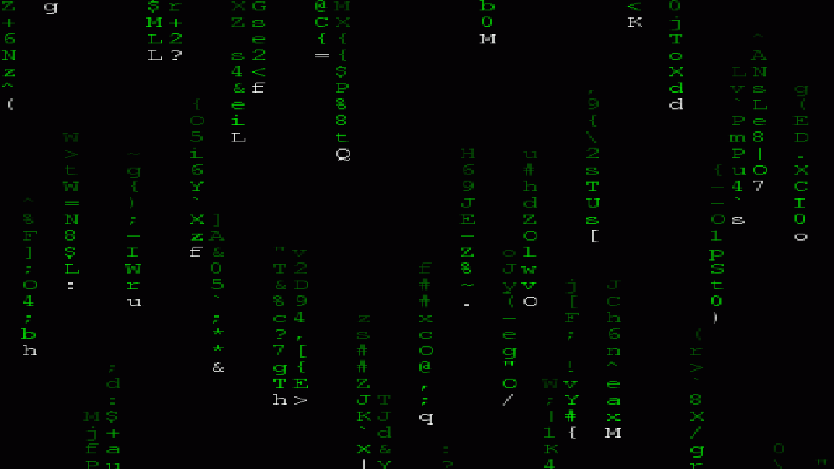

Introduction to Computational Biology
Lecture 0
BIOL 4360, BIOL 5360, MARB 6360
Dr. Chris Bird

Slide 2
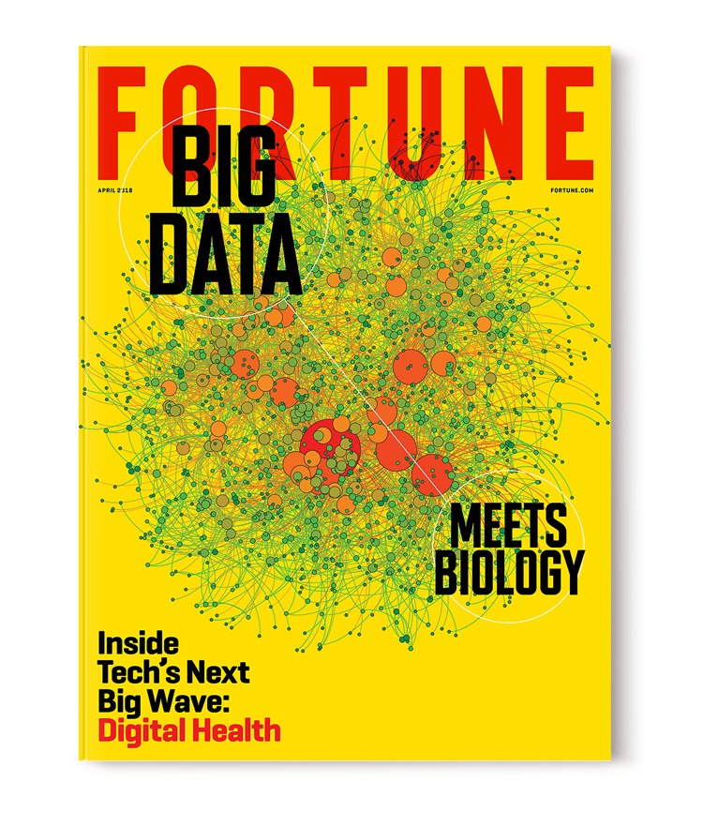
Why are computational skills important for biologists?
Increasing data size and complexity
Increasing sophistication of statistical and mathematical analyses
Transparency, reproducibility, and documentation

Slide 3
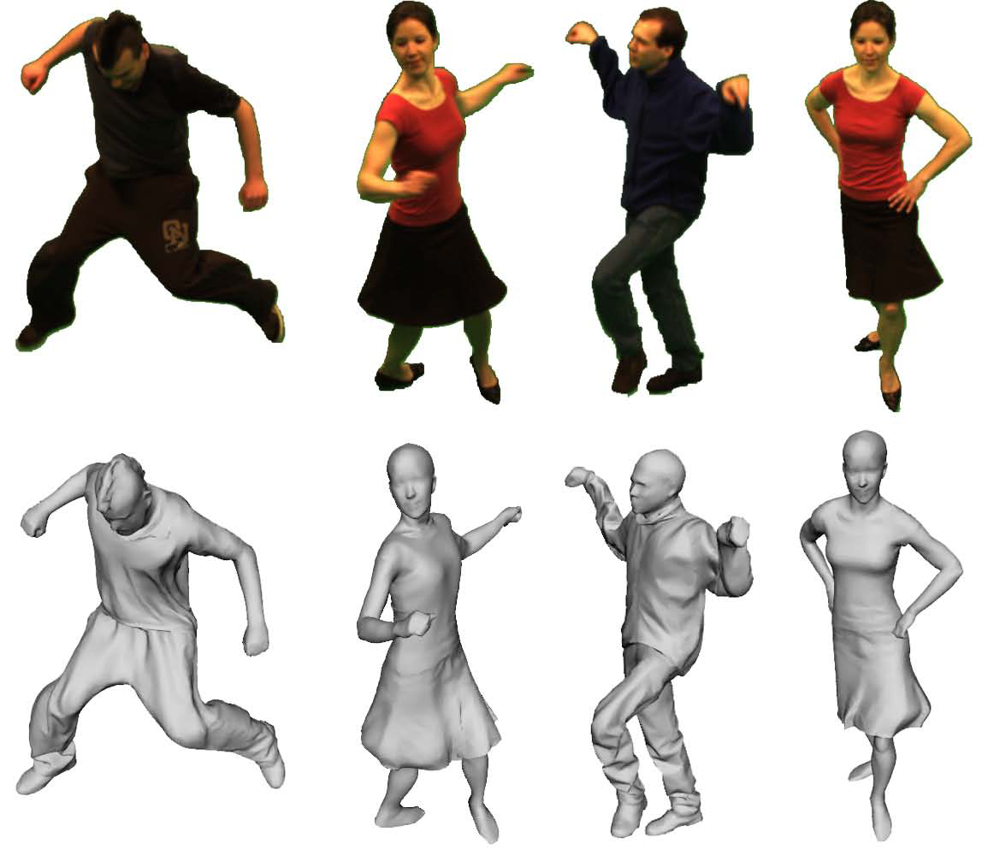
Why should biologists be interested in developing computational kung-fu?
Automate impossibly tedious, monotonous, and lengthy tasks
Increased rate and significance of discovery
Career success
Maximize potential

Slide 4

Why did I choose to develop this course?
Historical lack of computational courses for biologists
Steep learning curve
The days of easily succeeding in biological research without computational knowledge and skill are over

Slide 5

If you so choose, I will show you the philosophy of data science
Automation
Interconnection
Modularity
Reproducibility
Organization
Comprehension
Openness
Simplicity
Correctness

Slide 6
Philosophy of Data Science
All data is digitized and stored in files
Data manipulations and analyses are documented in computer scripts that interface with data files and require no additional human intervention to complete analysis
Data & scripts are published with the report and openly accessible to all
Data Files
Publications & Reports
Computer Scripts

Slide 7
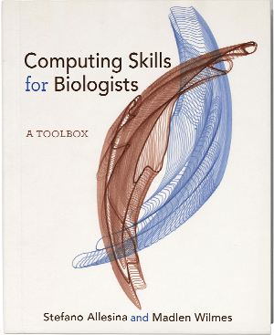
We Used to Follow The CSB Text Book, It’s a Good Resource But Not Required
Provides you with requisite breadth of tools at the expense of depth
Showcase of Linux, Python, R
Organized into 10 chapters, theoretically 1 per lecture
Goal is to flatten your learning curve
https://computingskillsforbiologists.com/

Slide 8

We are Going to Learn How to Use R
You will learn core principles of R that aren’t taught in other courses that expect you to use R
You will learn to use `tidyverse`, which was masterminded by the Author of the R for Data Science book, which is free.
https://r4ds.had.co.nz/

Slide 9
Learning Objectives
Recognize, describe, and organize data into standard biological data structures
Locate scientific data repositories and extract data
Operate UNIX/LINUX computers from command line
Construct and modify computer programming/scripting logic structures for processing biological data
Use version control software (git)
Describe and use regular expressions to query data
Typeset with LaTeX or MarkDown
Use the most popular open-source tools for biological data manipulation
Shell scripting (bash)
Scientific computing (python)
Statistical computing (R)
Tool repositories

Slide 10
Lectures
Environment for you to learn new concepts
Hands-on with computers
Power-point & github driven
On webex
Independent exercises w/ MS Forms through GitHub

Slide 11
Questions?

Slide 12
Biological Data
Lecture 0.1
BIOL 4590, BIOL 5590
Dr. Chris Bird

Slide 13
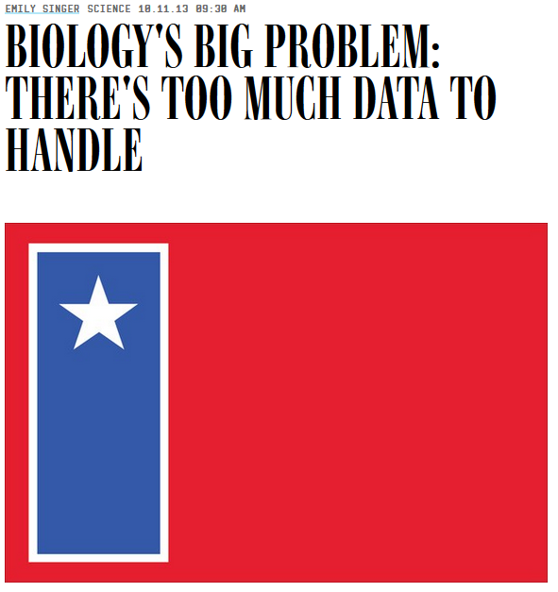
Big Data Biology
Massive amounts of data
Associated tools, processes, procedures
Volume, velocity, acceleration
Goal is to tame the data
Examples: DNA, climate, weather, remote sensing, GIS, all “omics”, populations
..and not enough biologists with the motivation, interest, and/or skill to address the issue

Slide 14
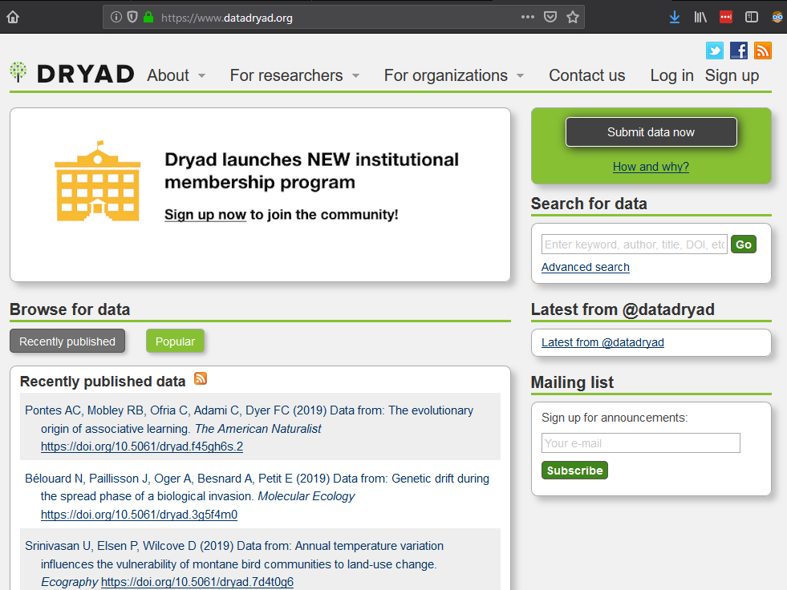
Repositories for Data Big and Small
Data associated with scientific papers should be published
Owned by the people
Should be freely available
Promotes acceleration of knowledge generation
All Types of Data
www.datadryad.com
DNA & Proteins
https://www.ncbi.nlm.nih.gov/
GIS
https://data.usgs.gov/datacatalog/#fq=dataType%3A(collection%20OR%20non-collection)&q=*%3A*
Oceanographic
https://data.noaa.gov/datasetsearch/
Too many to list

Slide 15
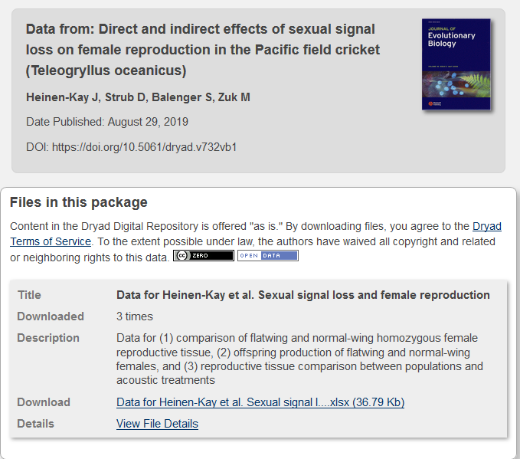
Let’s Explore a Data Set Published in Dryad
www.datadryad.org
Find Data from:
Direct and indirect effects of sexual signal loss on female reproduction in the Pacific field cricket (Teleogryllus oceanicus)
Download the data and view it in MS Excel
It is important to open files, look at data, and understand how it is organized

Slide 16
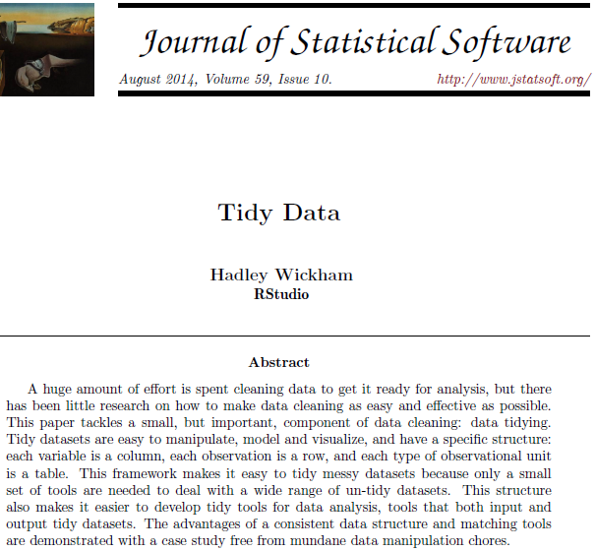
Tidy Data (Wickham 2014)
Each row is the “smallest unit of observation”
Ex: an individual fish
Each column is a variable or dimension of information about the units of observation
Ex: somatic mass

Slide 17
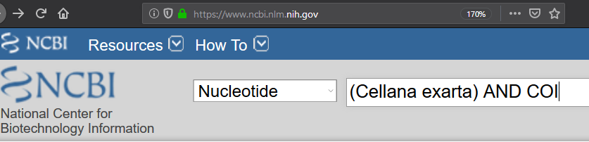
Common Data Formats & Structures are Not Always Tidy
https://www.ncbi.nlm.nih.gov/
Conduct the following search

Slide 18
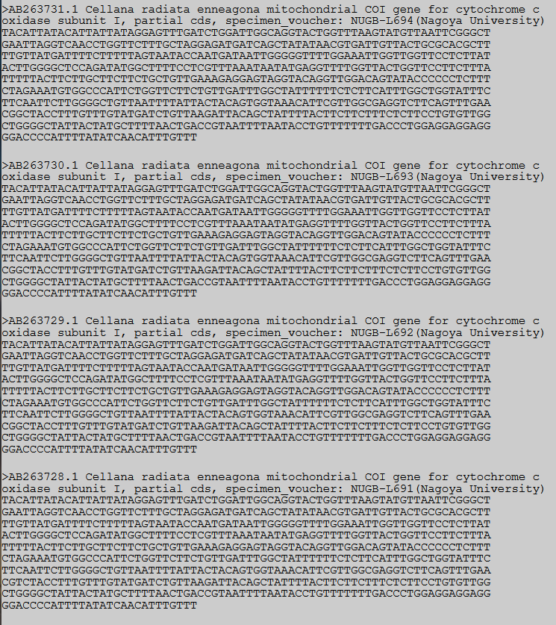
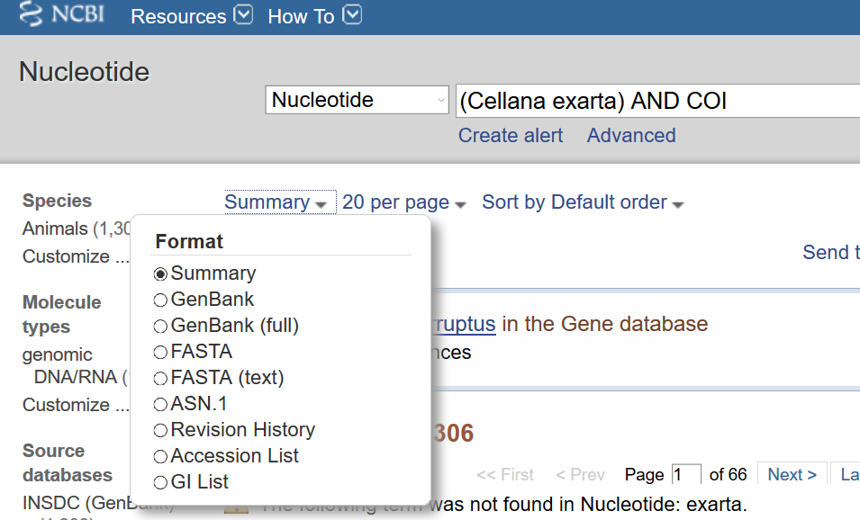
GenBank Supports Several Formats, None Are Tidy
https://www.ncbi.nlm.nih.gov/
Switch to FASTA (text)

Slide 19
Common DNA Data Format
https://www.ncbi.nlm.nih.gov/
Switch to FASTA (text)
Wikipedia is an excellent resource for describing data formats
FASTA Format
DNA
Lines beginning with `>` contain the ID of the unit of observation
Lines that don’t being with `>` contain information, each character (nucleotide) is a dimension of the unit of observation

Slide 20
Data Formats
I will emphasize Tidy format
Many fields of Biology have their own particular and peculiar data formats
There are tools available for handing and converting among data formats
Some data formats are intimidating, at first
There will exist published descriptions of these
Duckduckgo: sam specification
This is a common “big data” format for next generation sequencer data
Take a deep breath, it’s not as intimidating as it seems

Slide 21
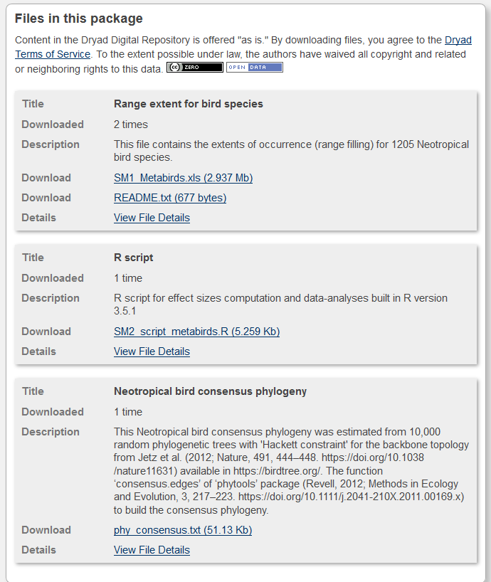
Repositories Can Include Scripts for Processing, Analyzing, & Visualizing Data
www.datadryad.com
Find Data from:
Meta‐analyzing the likely cross‐species responses to climate change
Explore the files
*.xls, *.txt,
The extension indicates file format NOT data format
R script
R is a statistical computer language
This file will analyze the data exactly the way it was reported in the publication

Slide 22
Recall The Philosophy of Data Science
All data is digitized and stored in files
Data manipulations and analyses are documented in computer scripts that interface with data files and require no additional human intervention to complete analysis
Data & scripts are published with the report and openly accessible to all
Data Files
Publications & Reports
Computer Scripts

Slide 23


Slide 24
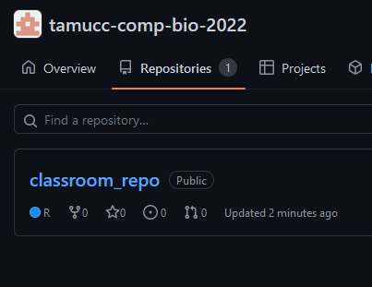
GitHub – A Repository of Sorts
A company
Website is designed to aid in developing code, like an R script
It also serves as a repository for data, code, and scripts
Efficient mechanism to disseminate your code to users
Can also be used to organize a class
https://github.com/Ph-IRES

Slide 25
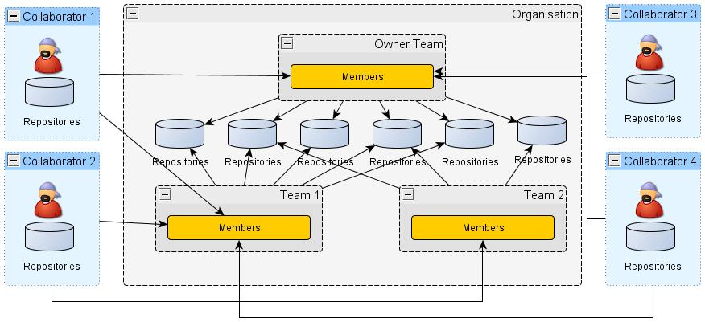
Conceptual Diagram of a GitHub Organization

